Slide 1
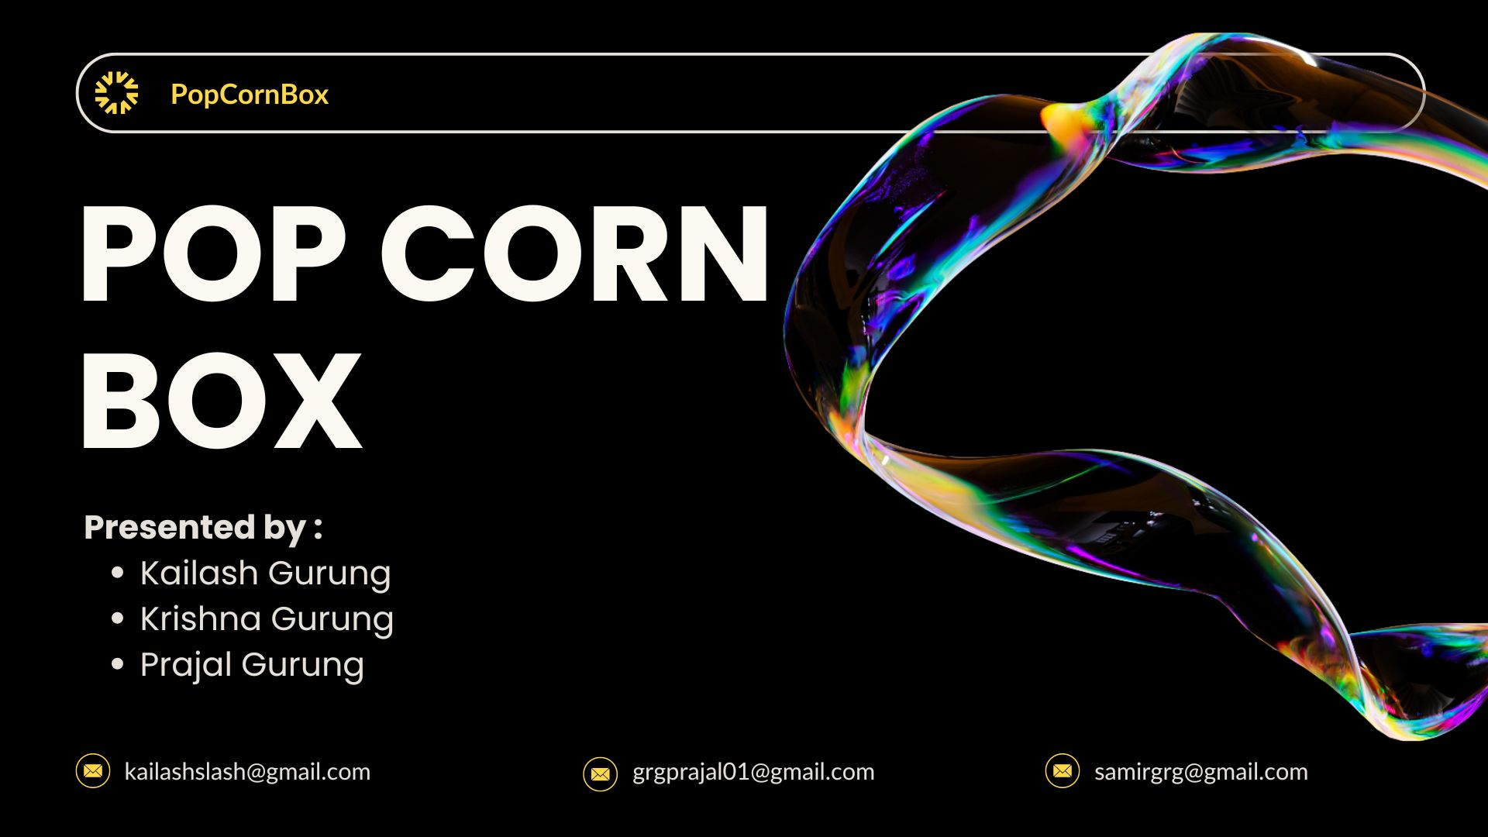

Slide 2
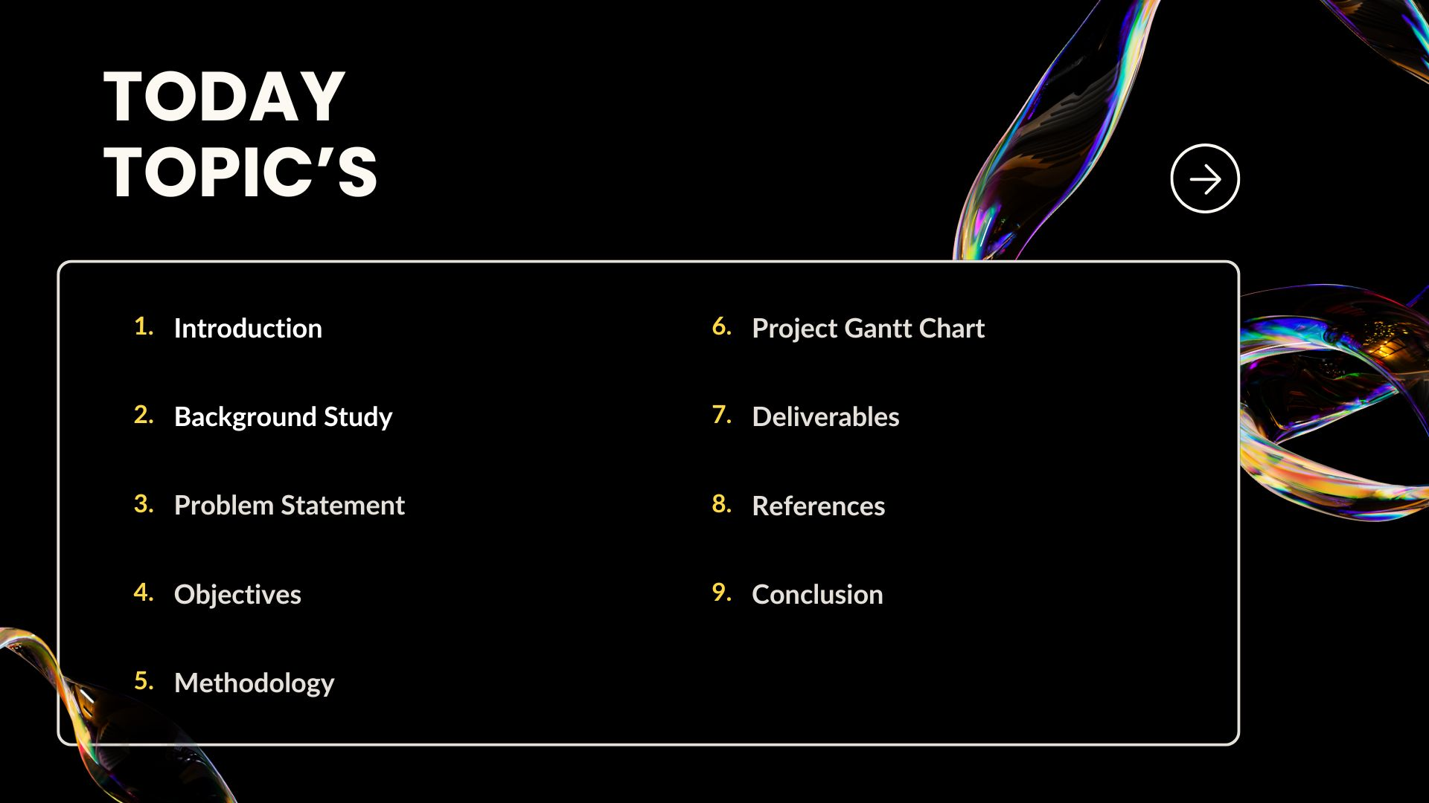


Slide 3
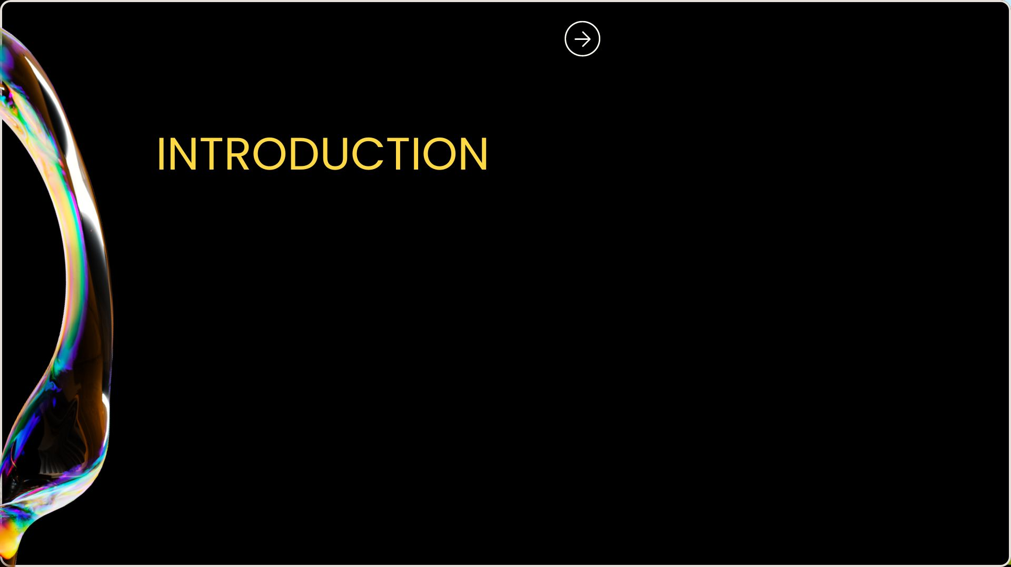
A Movie Streaming App is a specialized software application designed to allow
users to watch movies over the internet. This platform aims to provide an on-demand entertainment service, where users can access a vast library of movies without needing to download its files . The primary goal of this project is to efficiently manage and deliver a vast array of video content to users while ensuring a high-quality, uninterrupted streaming experience.

Slide 4

We initiated our investigation by recognizing the necessity for a Movie Streaming
Web Application. Initially, our research was focused on identifying the underlying reasons
that necessitate the implementation of “PopCornBox”. We gathered various project
requirements through visiting website like Netflix, Amazon Prime Video, Hulu, Disney+, etc.

Slide 5
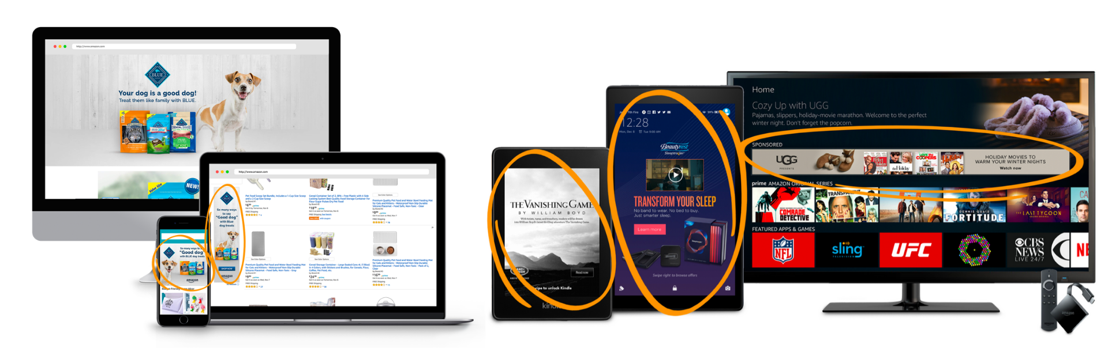
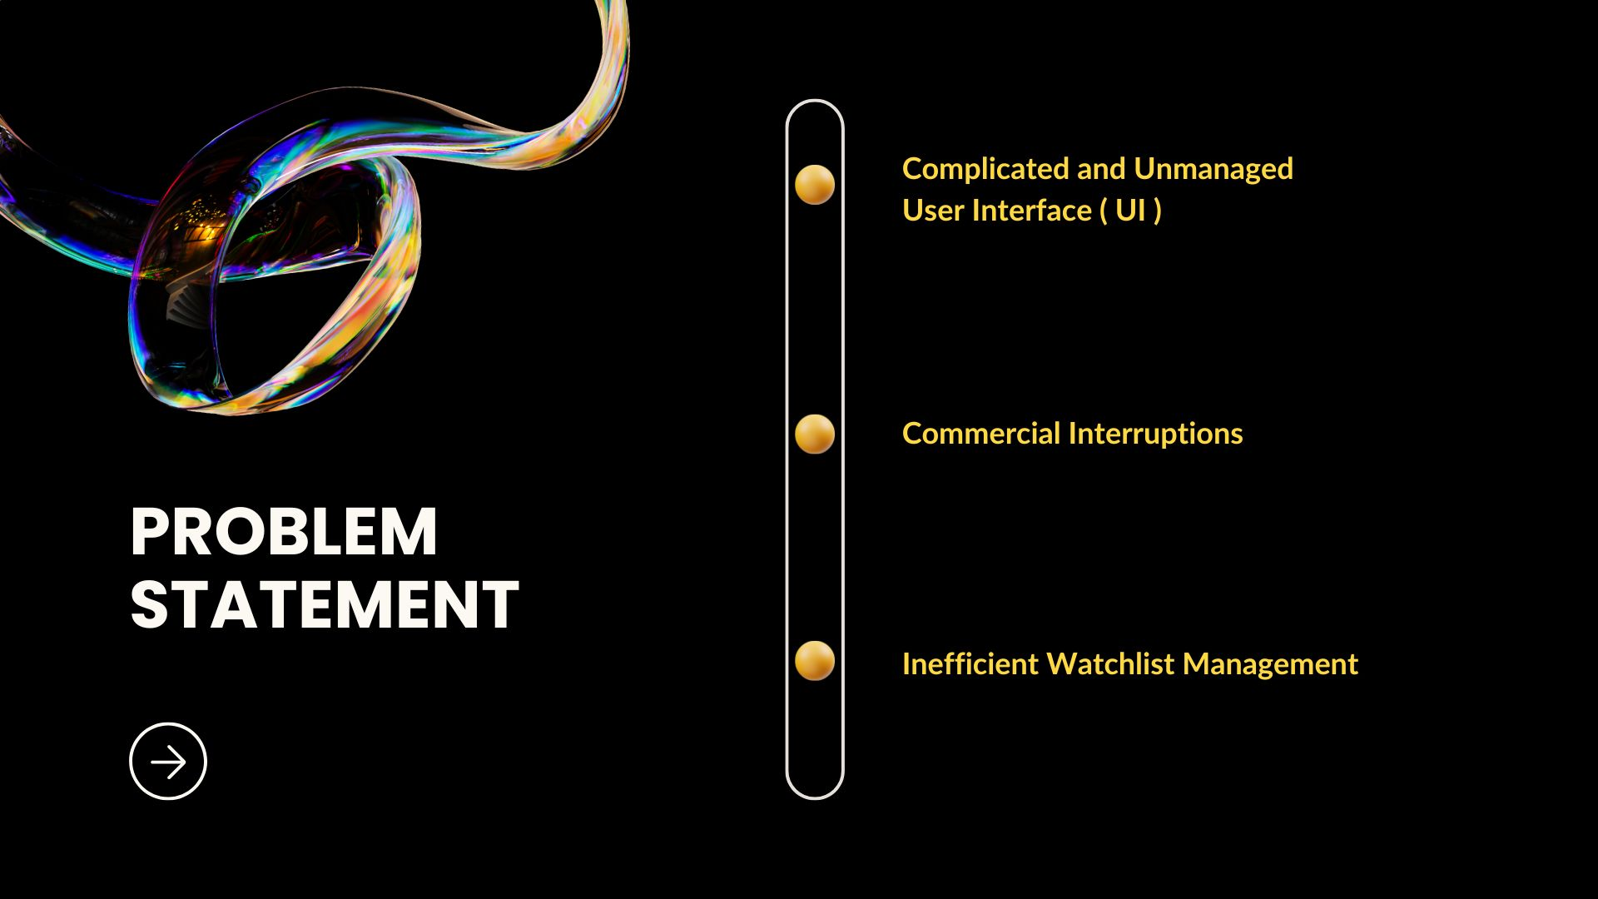


Slide 6
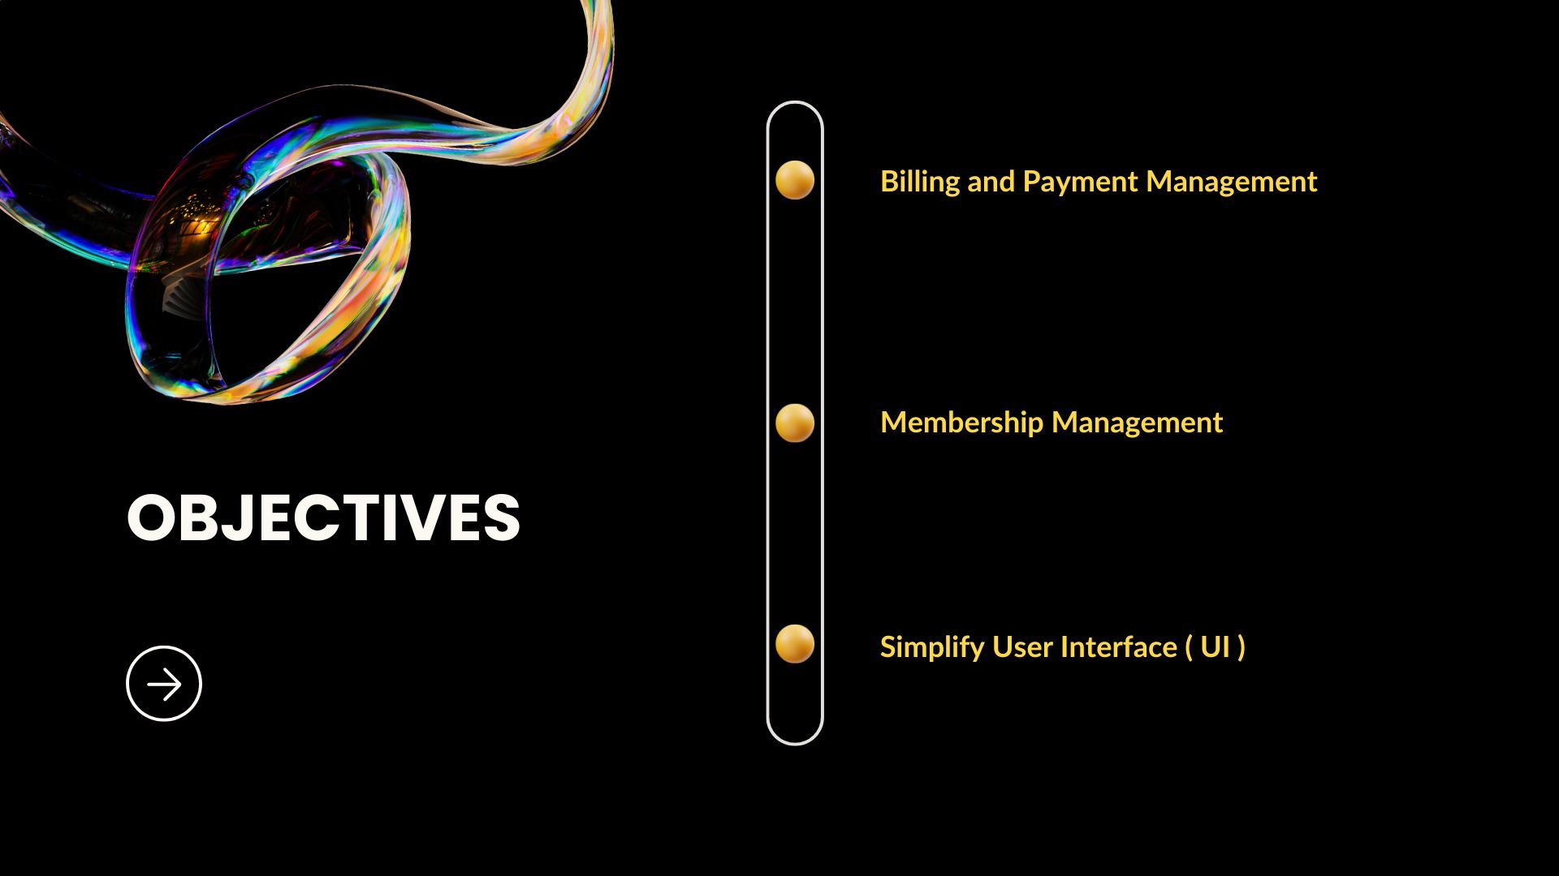

Slide 7
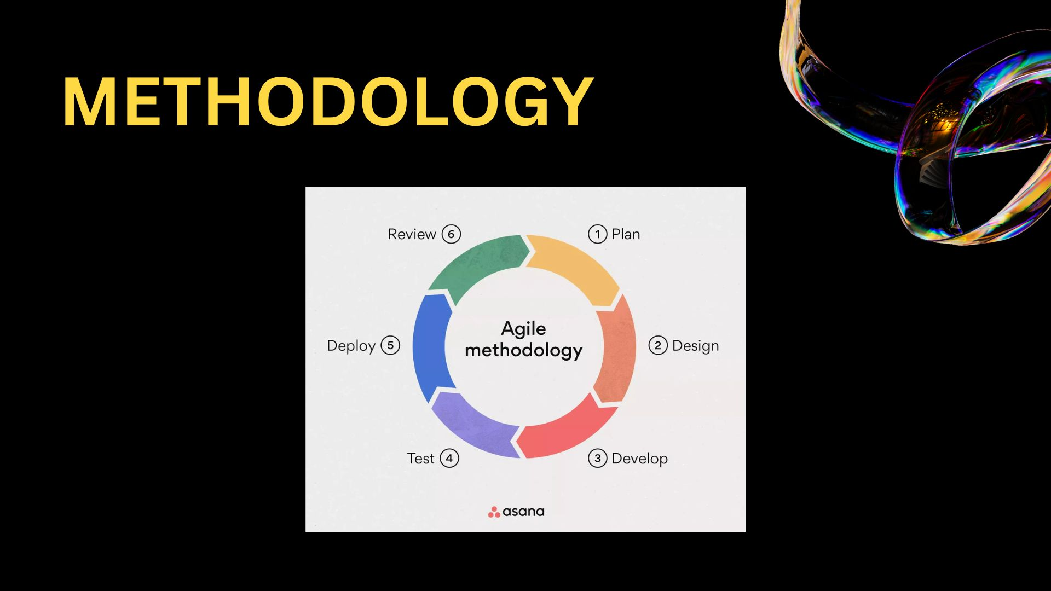

Slide 8
Project Gantt Chart :

Slide 9
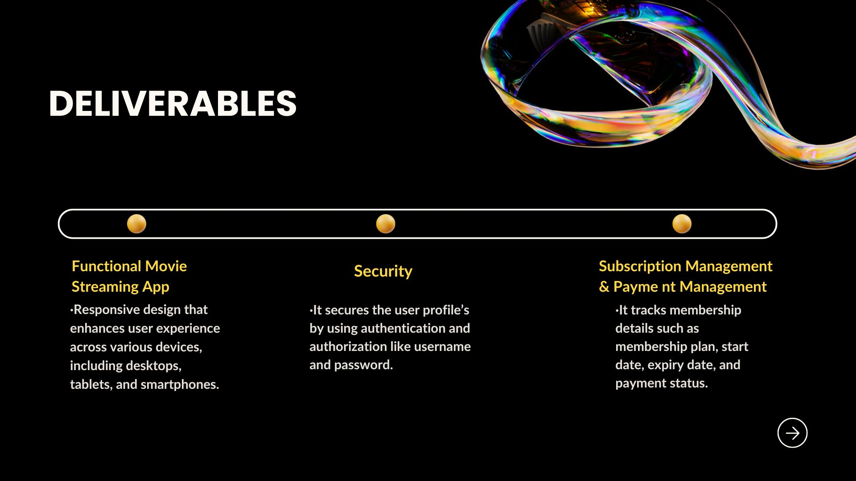

Slide 10
REFERENCES :
Prime, A. (2005, February 2). Retrieved from Prime Video: https://www.primevideo.com
Netflix. (1997, August 29). Retrieved from Netlfix: https://www.netflix.com
Hulu. (2007). Retrieved from Hulu: https://www.hulu.com(2008).
Retrieved from Asana: https://asana.com/resources/agile-methodology

Slide 11
